Slide 1
BES SEEBURGER COE Experience, Capabilities, Offerings

Slide 2



BES SEEBURGER COE – At a Glance
Who we are
What we do
Experienced global team: More than 20 years of B2B&EDI experience and more than 15 years of SEEBURGER experience on average
We have a strong IT Background – we ran our own Integration environments for HP, HPE and Compaq
Serving large and small corporate clients worldwide – with operations, consulting and project implementations
Run the full solutioning stack – from Platform setup and Application build to B2B process design and implementation
Have built, modernized and migrated EDI and B2B Environments for more than 20 years
Implement Best Practices and are well versed in topics around Audit and SOX compliance as well as Data Security
Manage and run operations of all sizes and complexities – including delivery from cost-competitive locations
We are running DXC’s own EDI and B2B Solutions with the offerings, processes and knowledge we bring to our clients
Deep expertise – from Platform and Infrastructure to Mapping, Business Analysis and Operations
Integrated into DXC BES – access to >200 Global B2B Professionals

Slide 3
Hosting Approaches
On-Premise
DXC VPC
Public Cloud
Flexibly Managed
Building SEEBURGER solutions on-site on existing infrastructure - for maximum control
Hosting SEEBURGER Solutions in the DXC Virtual Private Cloud – Let us take care of the Infrastructure
Leveraging existing partnerships with AWS, Azure etc. - for maximum flexibility
We can operate as much of your environment as required – from fully managed to client operated
Solutioning Approaches
Enterprise Gateway
Specialized Solutions
MFT
SME
We have built and run some of the largest EDI Gateways worldwide
We can tailor industry or use-case-specific Solutions
Managed File Transfer Solutions for your use-case
Need a small but solid EDI or B2B solution? We have options

Slide 4














DXC + SEEBURGER - Partnership for more than 15 years
Business Exchange Services (BES)
160,000+
Managed EDI Partners
35+ Years
EDI Competency since 1986
130.000+ Talent pool across Applications, Cloud/ITO and Security
1,750 / 3B Transactions p.a
BES Clients
10.000+ Customer
In more than 50 Countries
~6,000 Clients
200+ Fortune 500 companies
+25 Years
Multiple Industries – Covering global
Supplier & Trading Partner base
500+ Customers
Customs Competency
97%
Client Retention
15+ Years
SEEBURGER-Partnership
15+ Years
Successful collaboration with DXC/HP
60 Years
Innovation Experience
DXC VAN
Multiple Connectivity-Options
Factory
As a Project / on Demand
B16 $ / Year
Revenue
200+ Tech-Partner
Network of Best-of-Breed-Partners
150+ Countries
Global Presence
Migration
All projects: Migrations
Significant Investments into migration tools

Slide 5
DXC Business Exchange Services (BES)

Slide 6







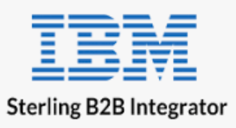
DXC Business Exchange Services (BES)
Snapshot
DXC Business Exchange Services provides scalable B2B/EDI solutions and services that allow clients to better communicate, connect and exchange data with their trading partners.
Fast facts
Investing in our capabilities
Silent Operations &
Support
1
1,000+ Integration skills
200+ B2B integration specialists working in emerging and traditional
technologies
DXC is continuously adding capacity through training and reskilling against key platforms
Supporting multiple industries, with focus on Manufacturing, Automotive, Retail, CPG, Energy & Healthcare
Seamless integration between internal & external integration capabilities
Advisory &
Service Roadmaps
2
Modernization &
Migration
3
1,750 customers
Global Reach - Deep technical & client facing skills
Global Delivery Footprint
Innovation &
Integration
4
Connecting 160,000+ enterprises
Processing billions of transactions
Key Technology Platforms
Global Delivery Hubs
Regional Centers
Leveraged Centers

Slide 7









DXC Business Exchange Services (BES)
DXC BES provides scalable B2B/EDI solutions and services that allow clients to better communicate, connect and exchange data with their trading partners.
B2B Managed Service
Managed File Transfer (MFT)
Trading Partner Onboarding & Management
B2B On-Premise
B2B Visibility
Small Partner Enablement
e-Invoicing
Advise
Partners
Build
Global Scale
Business Exchange Services
BPO and BPaaS
Analytics and Engineering
Applications
Security
Cloud Platform
IT Outsourcing
Modern Workplace
Treatment Options
DXC ENTERPRISE TECHNOLOGY STACK
Transform
Applications Modernization
Enterprise Applications and SaaS
Managed Applications
Modern Applications Development
Testing and Digital Assurance
Manage
Notes:
We address the entire applications integration lifecycle, either as part of an end-to-end enterprise transformation or a specific business initiative or technology project
Application Integration Services sits within the Application Services layer of the DXC stack
It provides the end-to-end capabilities needed to integrate application and data across an increasingly complex of ecosystem of endpoints
We provide three major categories of services grouped by Advise, Build and Manage, and can engage at any entry point from augmentation of staff to fully managed integration environment
Advise: Business and technical consulting services to help customers evaluate and understand the potential opportunities and impacts of the digital economy upon their enterprise
Build: Deliver the API and integration solutions needed to support client business operations and strategies through design, POCs, solution development and implementation, technology advice and ecosystem support
Manage: Apply service management disciplines to manage client API and integration services, providing comprehensive integration services to the enterprise

Slide 8
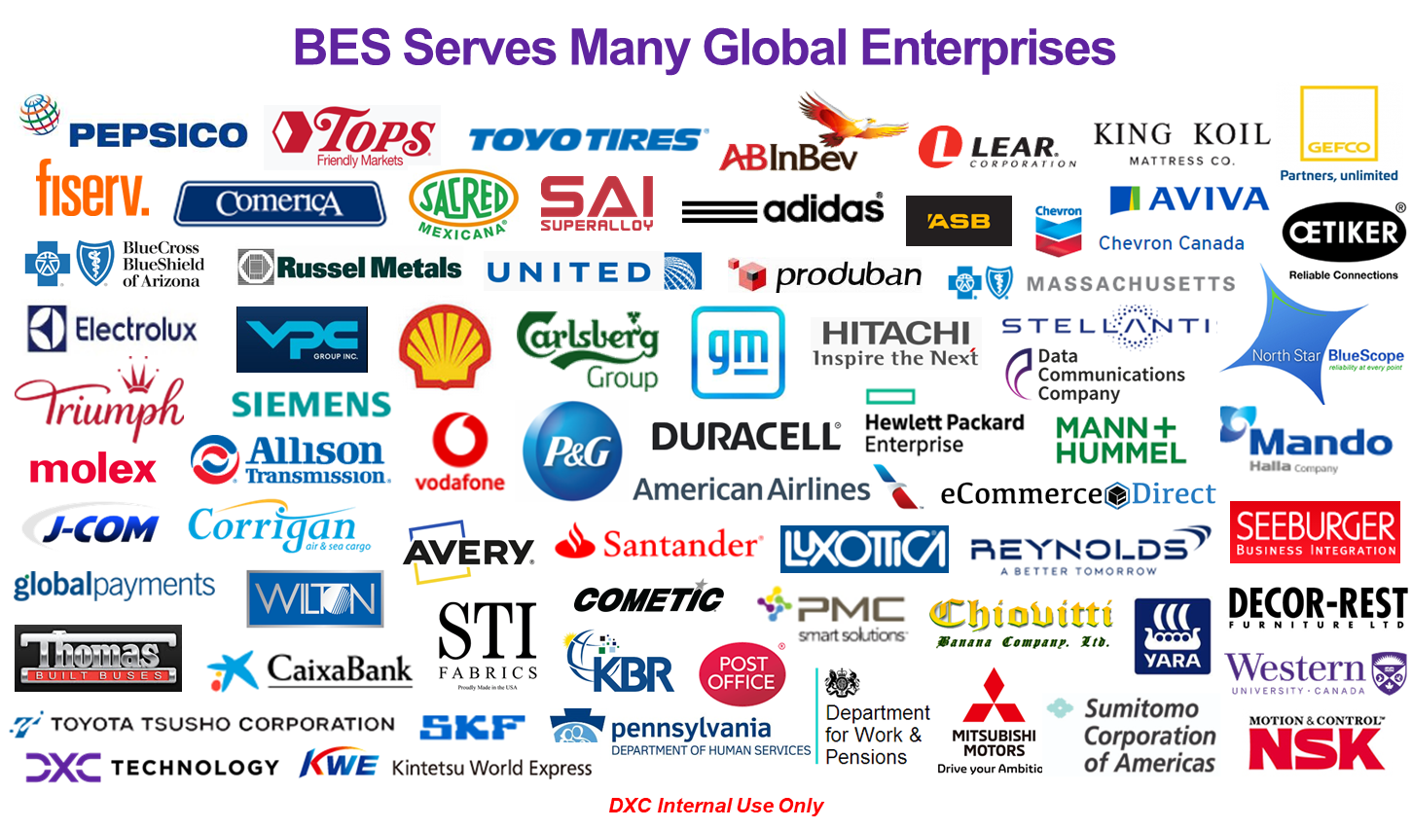

Slide 10
Backup

Slide 11


General Service Models DXC/SEEBURGER Flexibility for different Situations based on a Global Partnership Agreement
Service Examples
Prime
SEEBURGER
Mapping Factory
Consume Mappings aaS
T-Shirt Sizes
A
E2E Service
DXC
Complementary,
Integrated
E2E Service
SEEBURGER
Global Integration Platform
Migration to BIS Platform
Run BIS onPrem/inCloud(s)
B
DXC
DXC
Mapping PODs
Capacity based DevOps
Continuous improvement
C
E2E Service
SEEBURGER

Slide 12



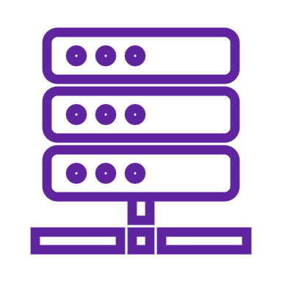









DXC at a glance….
60+
130,000+
200+
Years of innovation
Talent pool across Applications, Cloud/ITO and Security
Partnerships & Industry Affiliations
Partner of Choice
14,000+
97%
for various OEMs & CSPs
Applications Migrated and Transformed/ Year
Client Retention
9
~6,000
6
Digital Transformation Centers
Centers of Excellence driving innovation and IT Transformation
Clients
200+ Fortune 500 companies
Notes:
Experience matters. We’re extremely proud of our scale across critical skill sets globally. Here’s some of our key credentials at a glance.
Source for some stats: data collected for the Gartner DCO Hybrid Services MQ:
Virtual Server / Machines = 644,280
Number of Application migrated to Managed Private/Public cloud = 14,053
Digital Transformation Centers - https://whatwesell.dxc.com/dxc/support/client-engagement-centers/digital-transformation-center/
2.1M+ ERP users supported – ECA metric
Source from Gartner DCO Hybrid Svcs MQ:
Total ERP users supported 2,120,592
https://www.crn.com/news/running-your-business/turning-technology-into-business-value-the-2019-solution-provider-500

Slide 13
Appendix

Slide 14
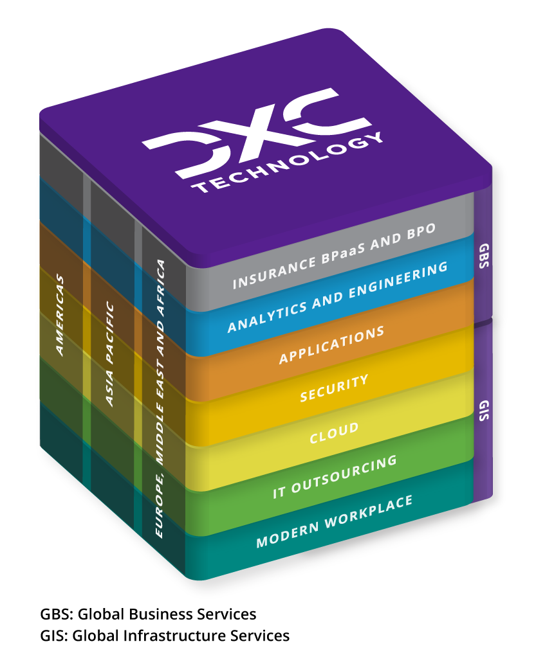
Unlock your Mainframe value with DXC Technology
Rethink the Mainframe by leveraging the Enterprise Technology Stack
We do this by
Helping our customers to simplify and optimize existing Mainframe Platform
Putting in motion a 360⁰ review of future mainframe options by a team of cross functional experts
Presenting a solution that takes care of existing investments while providing a path to modernize and transform the mainframe estate
Applying DXC’s cloud right approach to meet customers’ transformation and modernization goals
Supporting customers wherever they are in their journey to modernization

